Slide 1

Dr. Akhilesh Das Gupta Institute of Information Technology and Management
INDUSTRIAL TRAINING
PIXEL PHRASER
An Image Captioning Bot
TECHYAI

Slide 2
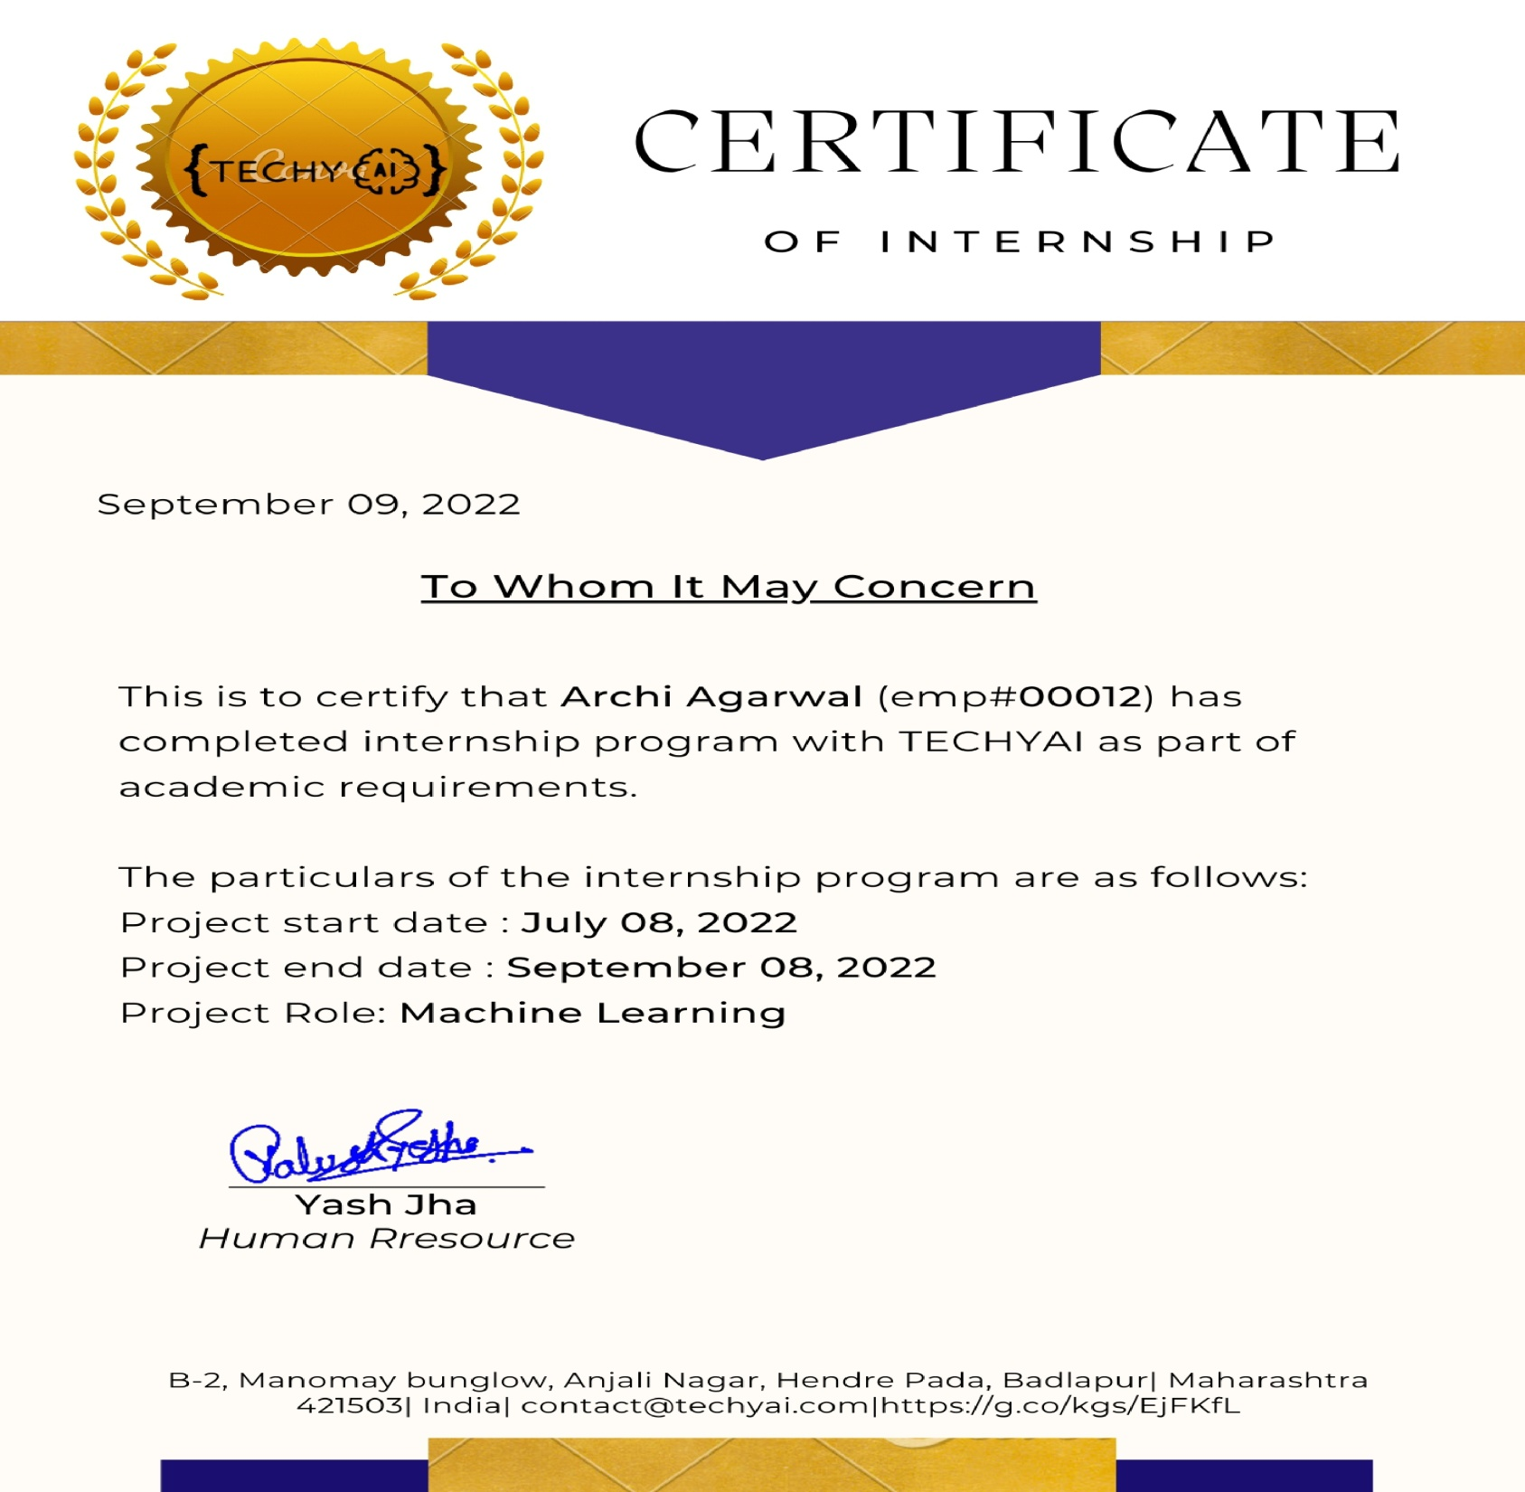
Certificate

Slide 3
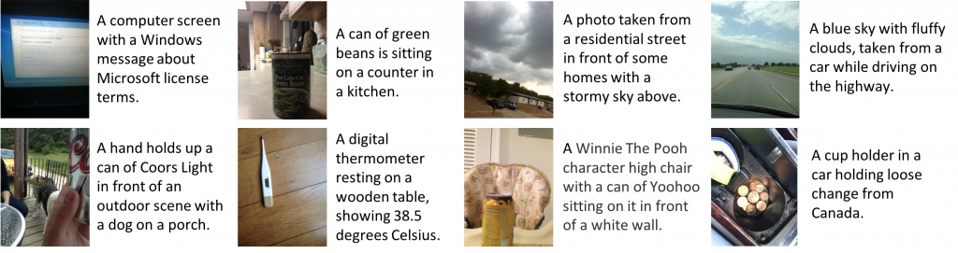
PIXEL PHRASER Introduction
Image Captioning is the task of describing the content of an image in words. This task lies at the intersection of computer vision and natural language processing.

Slide 4
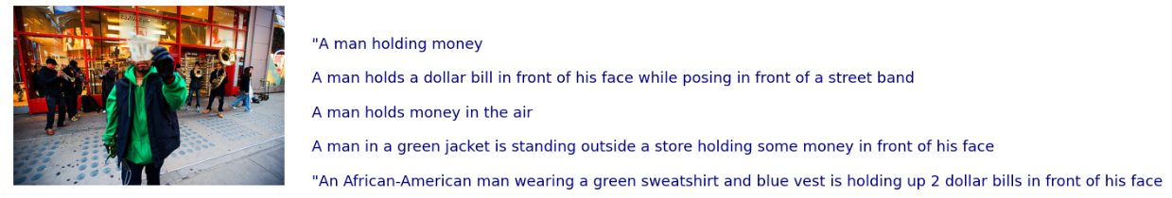
Flickr8k Dataset
Flickr8k dataset is publicly available at Kaggle. It has 8000 images, each labeled with 5 captions for better captions generation.

Slide 5
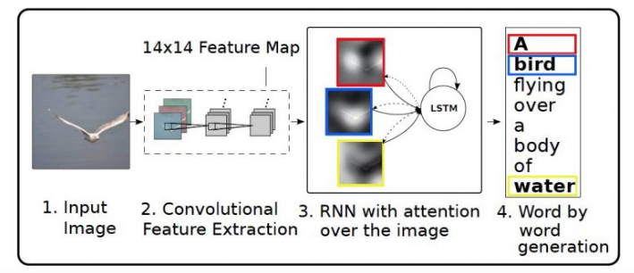
Architecture

Slide 6
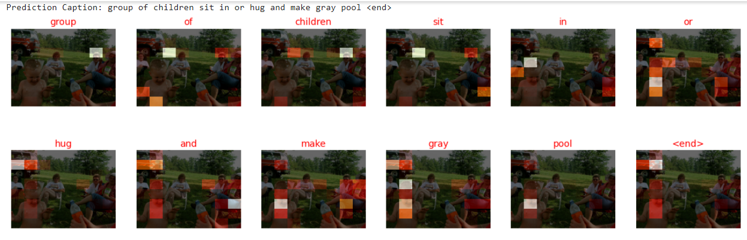
self attention mechanism
In Bahdanau or Local attention, attention is placed only on a few source positions. As Global attention focuses on all source side words for all target words, it is computationally very expensive.

Slide 7
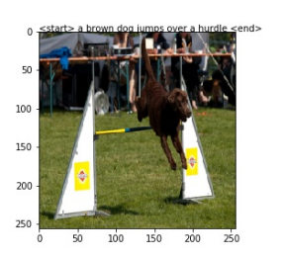
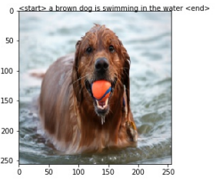
Working of the Project Model results
Generated Caption :
A brown dog jumps over a hurdle
Generated Caption:
A brown dog is swimming in the water

Slide 8
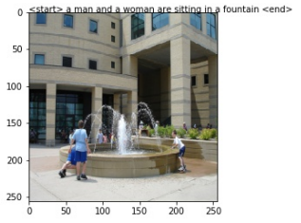
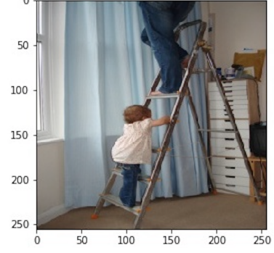
Working of the Project Model results
Generated Caption :
A man and a woman are sitting in a fountain
Generated Caption:
A little girl in white dress climbing a ladder

Slide 9
technologies used
Anaconda Software
Google Colab
Visual Studio Code
Deep Learning
Computer vision
Natural Language Processing

Slide 10
Conclusion
In this work we have designed an Image Captioning system using Attention model and NLP to generate audio captions of the fed image by virtue of Google text-to-speech library.
Medical image captioning is an instance of a task which may be beneficial to the medical community. Image captioning performed on mobile devices may become useful to visually impaired, especially when communicated verbally

Slide 11
Archi Agrawal 03815603119 B.Tech. (IT) Semester- vii
Department of Information Technology
Industrial Training
Submitted by:

